Slide 1
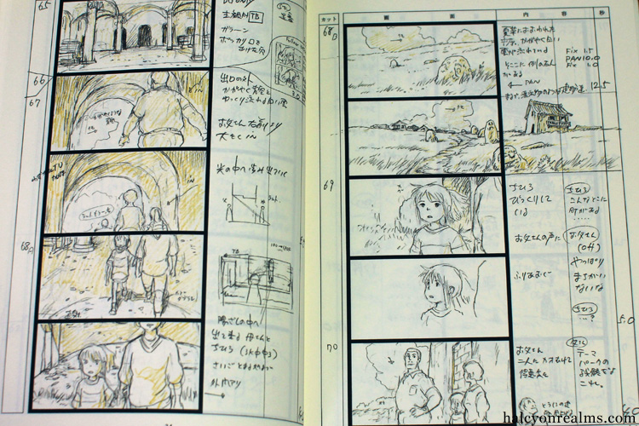
Storyboarding

Slide 2
Your Picture Book Assignment
You must:
Write, illustrate (or use a computer) and compose a 16 page picture book, using 100-400 words. Your target audience is Year 7’s.
Your picture book must have at least one image that bleeds over the page and one image that is contained.
Your picture book must focus on yourself and your growth as a person. NOT a pretend or imaginary character.
You must write a rationale stating how the images and the words in the text work together to create meaning, and the purpose of your story.
Your picture book can either be convergent or divergent, but must be consistent.

Slide 3
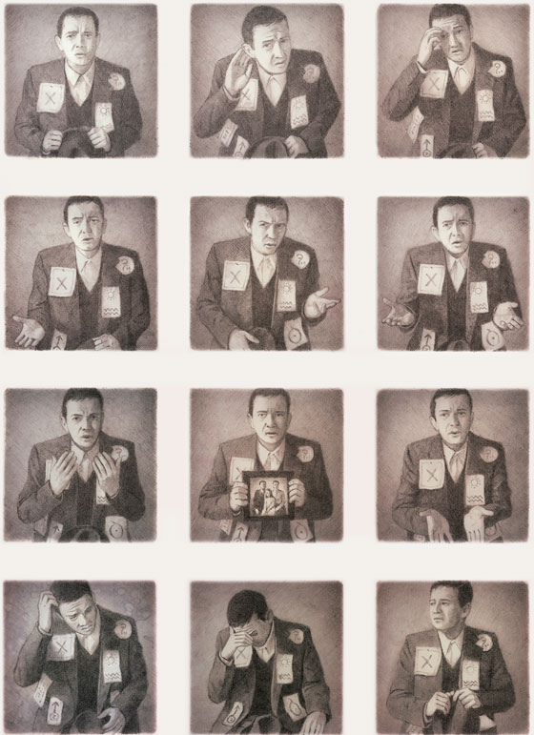
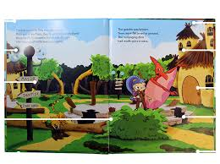

Slide 4
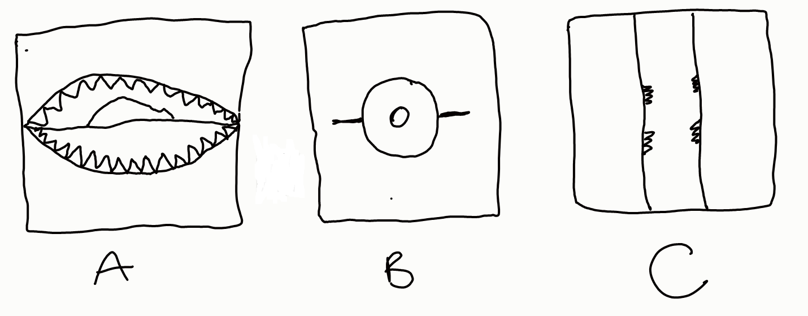
Do these images make sense on their own, or do they need words? Write down what you think these images are.

Slide 5
On their own, sometimes images don’t make sense: there is too little information in them for us to understand what they mean.
When words and pictures are put together, everything falls into place and a surprising new dimension opens up.

Slide 6
A: Last glimpse of Hawaii by a tourist being eaten by a shark.
B: A man wearing a sombrero, riding a push bike.
C: Koala climbing a tree on the far side of the trunk.

Slide 7
A storyboard is a sketch of how to organize a story and your images.
A storyboard helps you:
Define the parameters of a story within available pages.
Organize and focus a story.
Figure out your illustrations for each part of the story, and how it will all fit on the page.

Slide 8
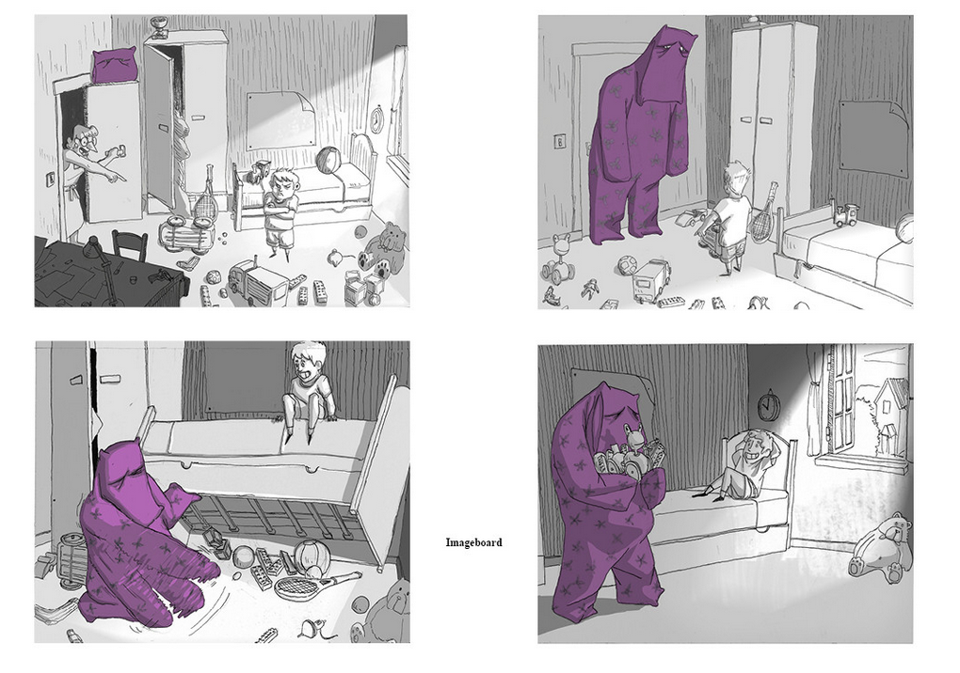

Slide 9
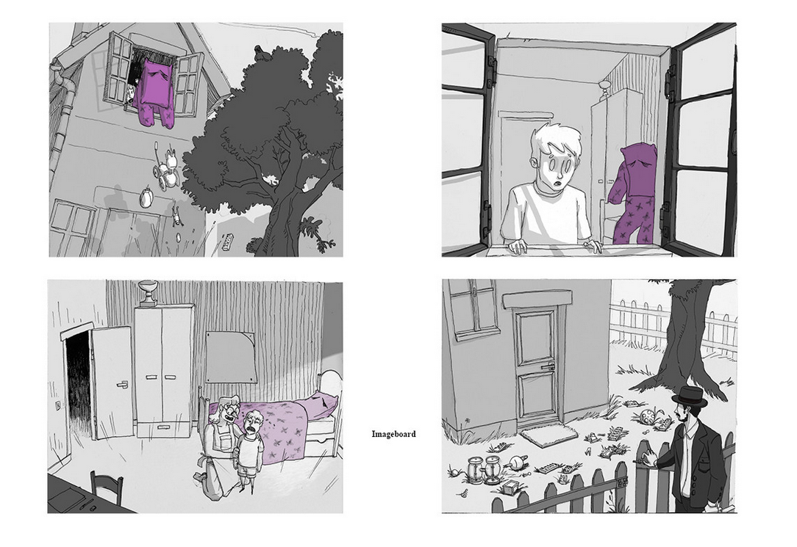

Slide 10
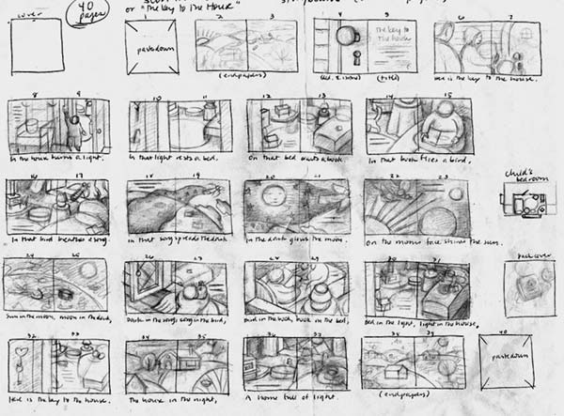

Slide 11
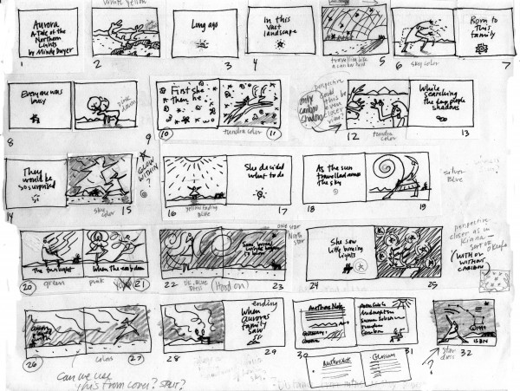

Slide 12
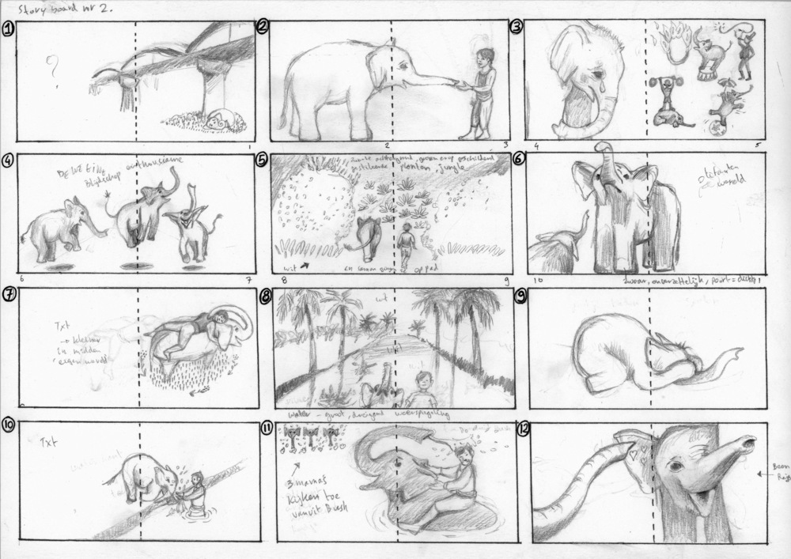

Slide 13
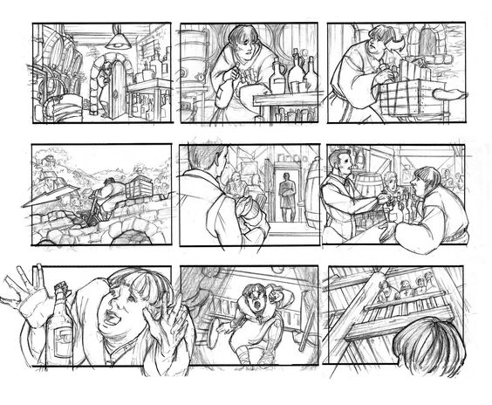

Slide 14
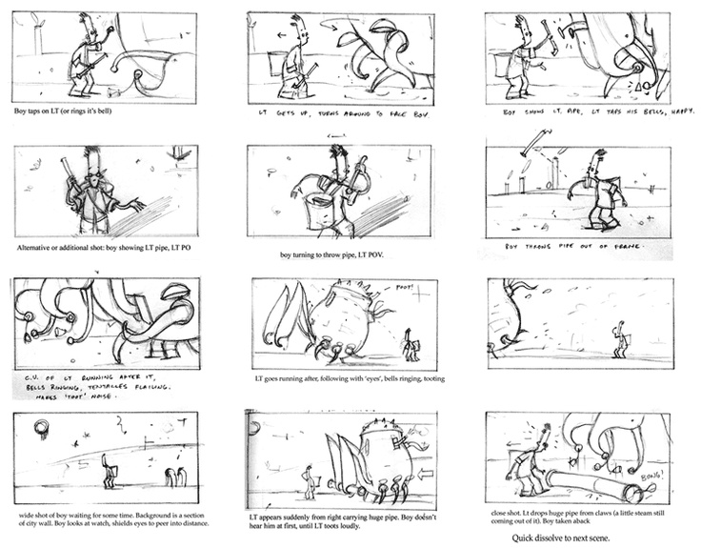

Slide 15
